Slide 1

SQL WORKSHOP
IECEP-MUSC
Notes:
WEWEWEWEW

Slide 2
REQUIRED INSTALLATION FOR THIS WORKSHOP
Windows OS Platform
Python 2.7 or Python 3.7
DB Browser for SQLite
MySQL Connector https://dev.mysql.com/downloads/connector/python/

Slide 3
OUTLINE
INTRODUCTION TO SQL
BASIC SQL COMMANDS
DATA TYPES
CONSTRAINTS
SHORT INTRODUCTION TO PYTHON
INTEGRATING SQL WITH PYTHON
ACTIVITIES

Slide 4
INTRODUCTION TO SQL
MEDYO BORING ☹

Slide 5
Relational databases
The relational database was invented in 1970 by Edgar F. Codd
A relational database is a set of formally described tables from which data can be accessed or reassembled in many different ways without having to reorganize the database tables.
In short, a database with many tables (relations) that contains rows (records) and columns (attributes)
SQL commands are used both for interactive queries

Slide 6
What is sql!?
Structured Query Language
Is a domain-specific language used in programming and designed for managing data held in a relational database management system
Lets you access and manipulate databases
Are used to perform tasks such as update data on a database, or retrieve data from a database.

Slide 7
WHAT CAN SQL DO!?
SQL can execute queries against a database
SQL can retrieve data from a database
SQL can insert records in a database
SQL can update records in a database
SQL can delete records from a database
SQL can create new databases
SQL can create new tables in a database

Slide 8
Basic Sql commands
Lezgo with the fun stuffs ☺

Slide 9
Keep in mind that…
SQL keywords are NOT case sensitive
“select” is the same as “SELECT”
But for formality, we will write SQL keywords in upper-case ☺
Semicolon after SQL Statements?
Some database systems require a semicolon at the end of each SQL statement.
We will use SEMICOLON (;) at the end of each SQL statements ☺

Slide 10
SELECT
The SELECT statement is used to select data from a database.
SELECT Syntax:
SELECT column1, coumn2 FROM table_name;
If you want to select all the fields available in the table, use the following syntax:
SELECT * FROM table_name;

Slide 11
WHERE
The WHERE clause is used to extract only those records that fulfill a specified condition.
WHERE Syntax:
SELECT column1, column2, ... FROM table_name WHERE condition;
Example condition: City=“Mexico”

Slide 12
INSERT INTO
The INSERT INTO statement is used to insert new records in a table.
INSERT INTO Syntax:
INSERT INTO table_name (column1, column2, column3, ...) VALUES (value1, value2, value3, ...);

Slide 13
update
The UPDATE statement is used to modify the existing records in a table.
UPDATE Syntax:
UPDATE table_name SET column1 = value1, column2 = value2, ... WHERE condition;
Note: Be careful when updating records in a table! Notice the WHERE clause in the UPDATE statement. The WHERE clause specifies which record(s) that should be updated. If you omit the WHERE clause, all records in the table will be updated!

Slide 14
DELETE
The DELETE statement is used to delete existing records in a table.
DELETE Syntax:
DELETE FROM table_name WHERE condition;

Slide 15
Create TABLE
The CREATE TABLE statement is used to create a new table in a database.
CREATE TABLE Syntax:
CREATE TABLE table_name ( column1 datatype, column2 datatype, column3 datatype, .... );

Slide 16
DROP TABLE
The DROP TABLE statement is used to drop an existing table in a database.
DROP TABLE Syntax:
DROP TABLE table_name;

Slide 17
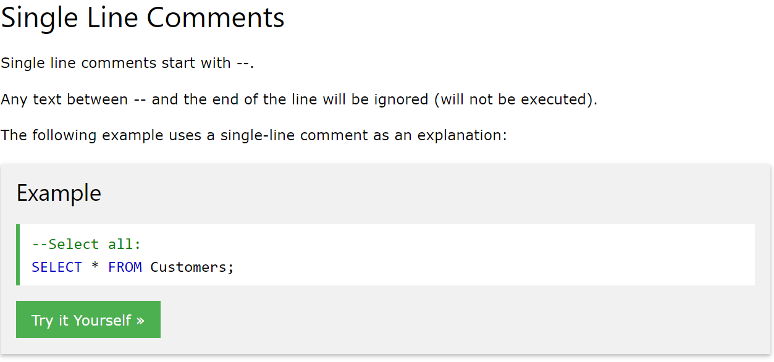
How to comment
Comments are used to explain sections of SQL statements, or to prevent execution of SQL statements.

Slide 18
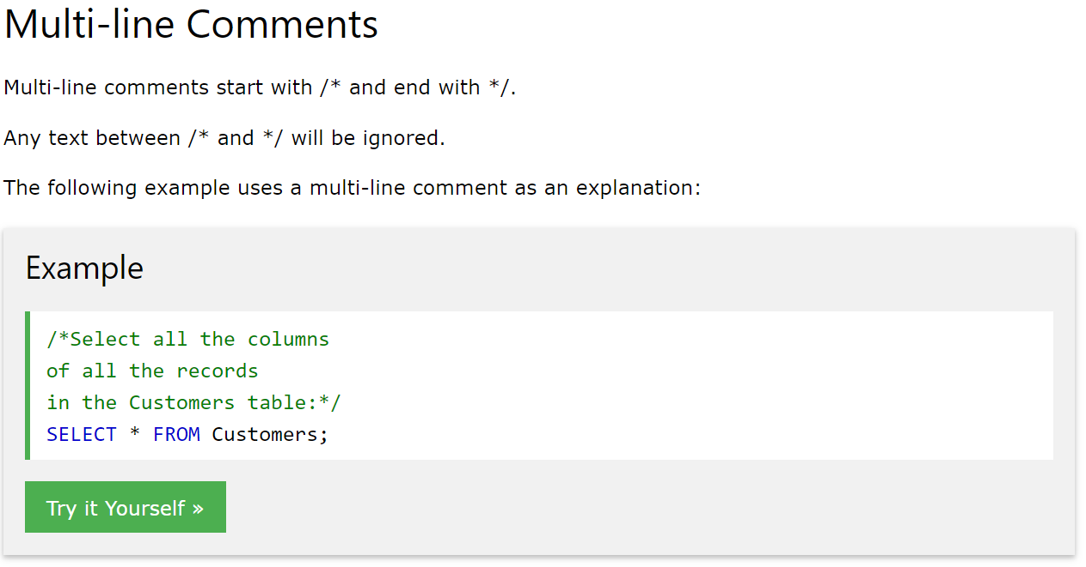
HOW TO COMMENT

Slide 19
DATA TYPES

Slide 20
Data types
The data type of a column defines what value the column can hold
VARCHAR(length) – character strings including Unicode, maximum length of 255 characters
TEXT – holds a string with a maximum length of 65,535 characters
REAL – decimals, floats, etc.
LONGTEXT – holds a string with a maximum length of 4,294,967,295 characters
BOOLEAN – TRUE or FALSE
INTEGER – it stores any integer value between the range 2^ -31 and 2^31 -1
BIGINT – greater range than INT

Slide 21
CONSTRAINTS

Slide 22
CONSTRAINTS
SQL constraints are used to specify rules for data in a table.
NOT NULL - Ensures that a column cannot have a NULL value
UNIQUE - Ensures that all values in a column are different
PRIMARY KEY - A combination of a NOT NULL and UNIQUE. Uniquely identifies each row in a table
PRIMARY KEY AUTOINCREMENT
Auto-increment allows a unique number to be generated automatically when a new record is inserted into a table.
Often this is the primary key field that we would like to be created automatically every time a new record is inserted.

Slide 23

Short introduction to PYTHON
YIEEEE BONUS LEARNING

Slide 24
WHAT IS PYTHON!?
Python is a programming language.
Python is a popular programming language. It was created in 1991 by Guido van Rossum.
It is used for:
Web Development (Server-Side)
Software Development
Mathematics or Data Science
System Scripting
Artificial Intelligence

Slide 25
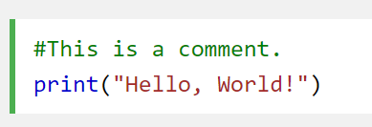
SYNTAX
Python Indentations
Where in other programming languages the indentation in code is for readability only, in Python the indentation is very important.
Python uses indentation to indicate a block of code.
Comments
Python has commenting capability for the purpose of in-code documentation.
Comments start with a #, and Python will render the rest of the line as a comment:

Slide 26
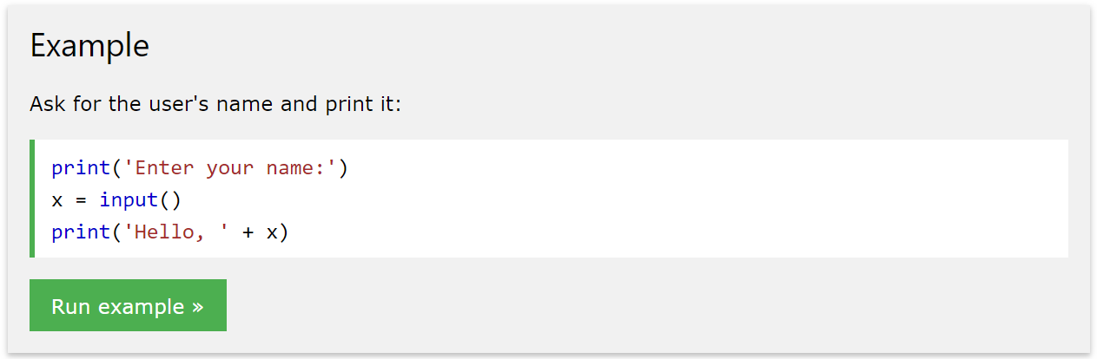
INPUT AND print

Slide 27
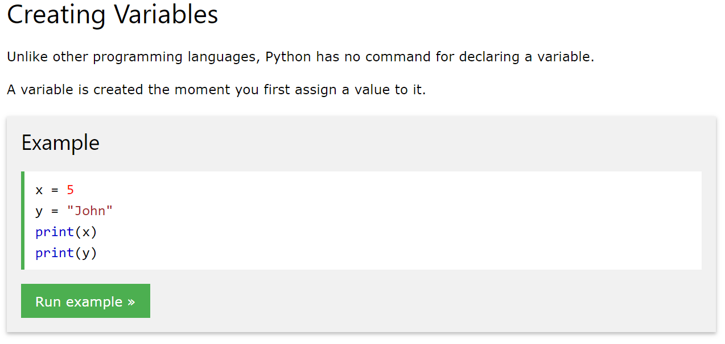
VARIABLES

Slide 28
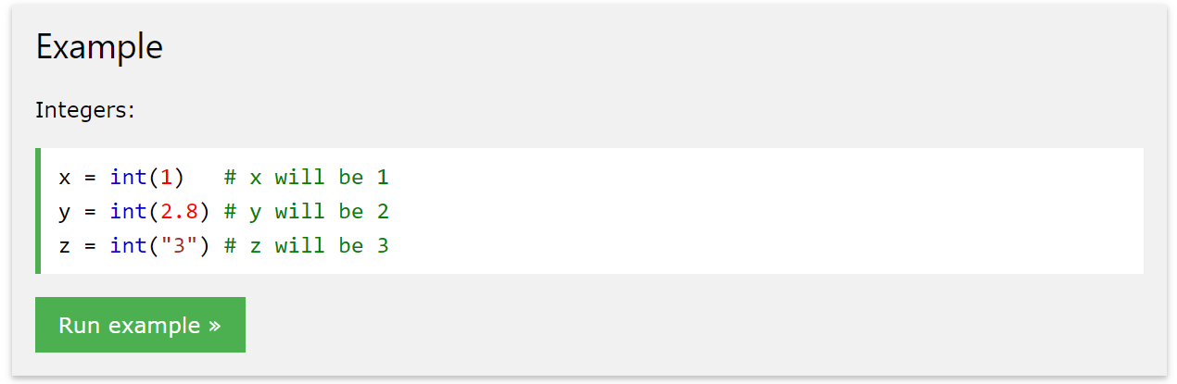
casting

Slide 29
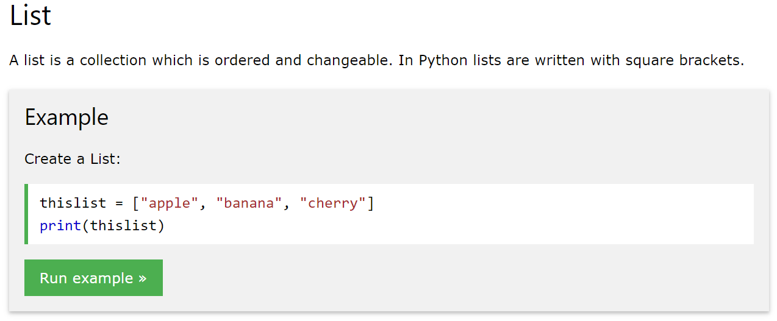
list

Slide 30
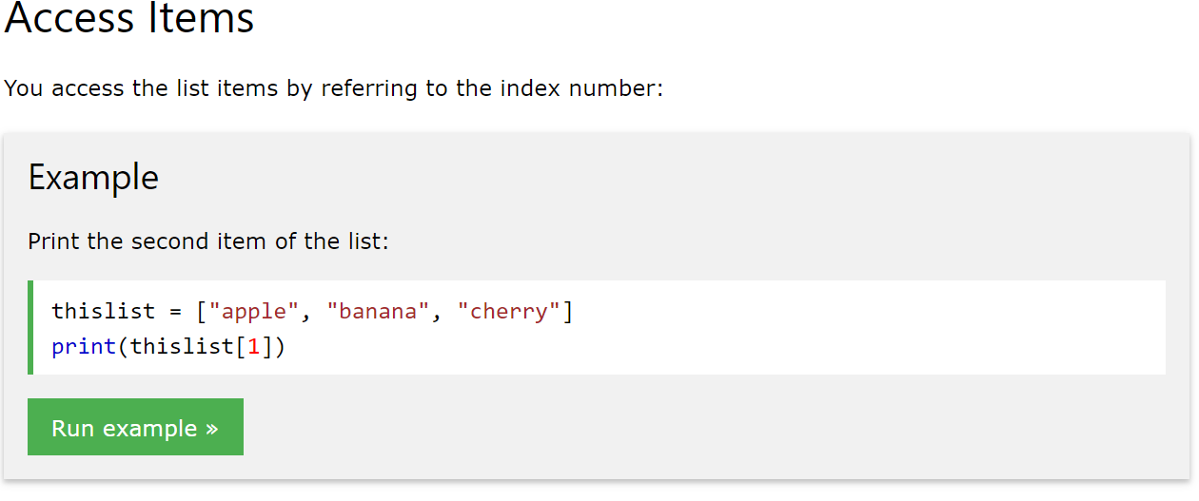
ACCESS LIST

Slide 31
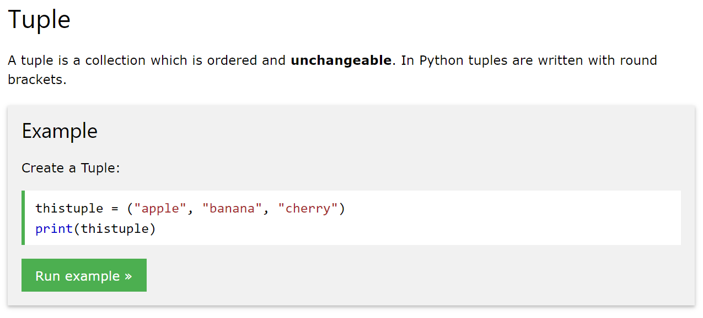
TUPLES

Slide 32
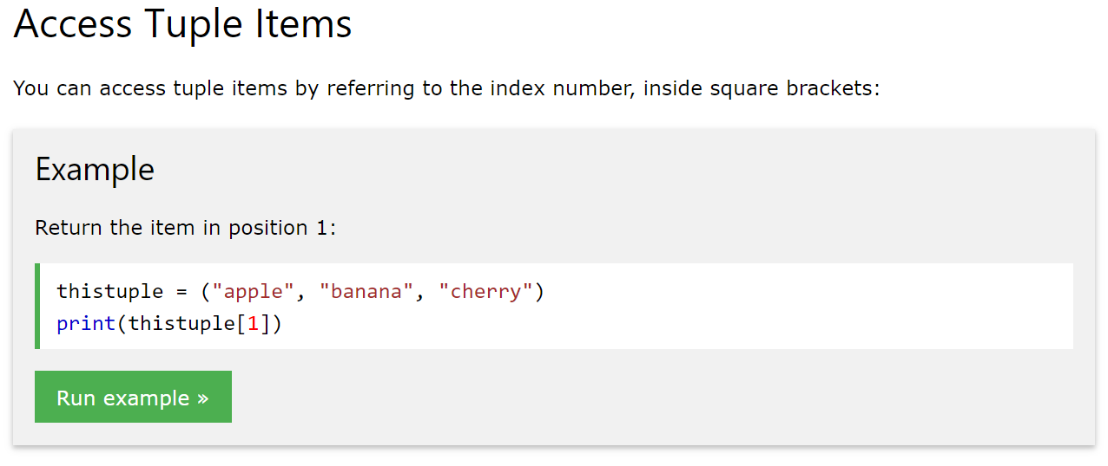
Access tuples

Slide 33
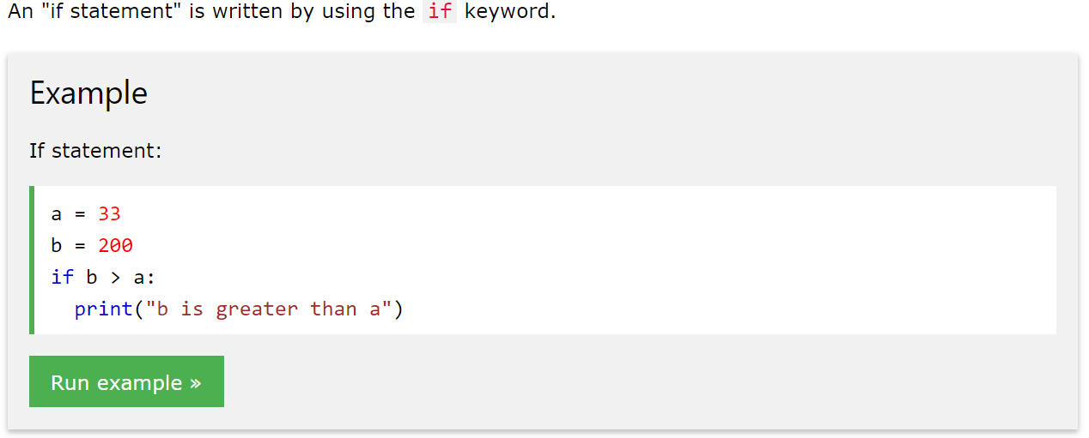
If statements

Slide 34
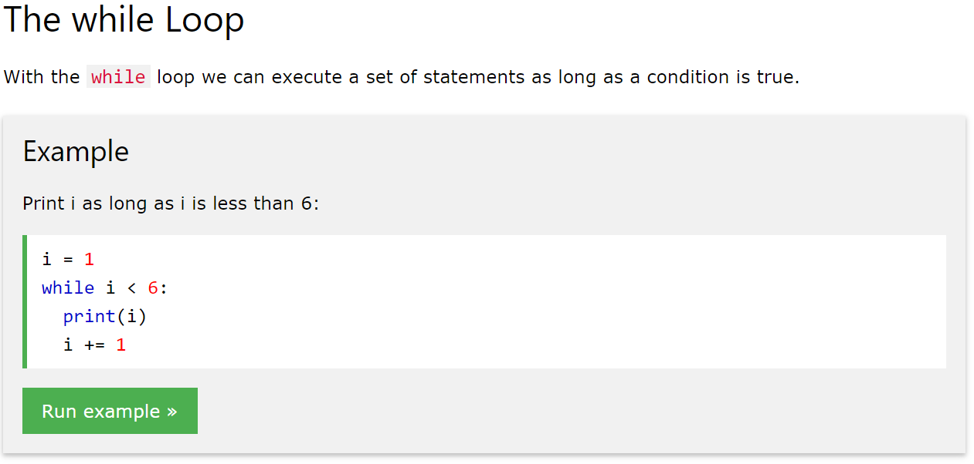
WHILE LOOP

Slide 35
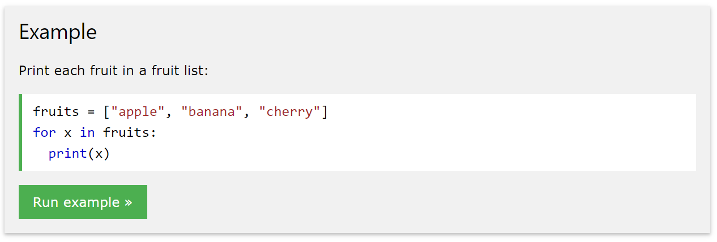
FOR LOOP

Slide 36
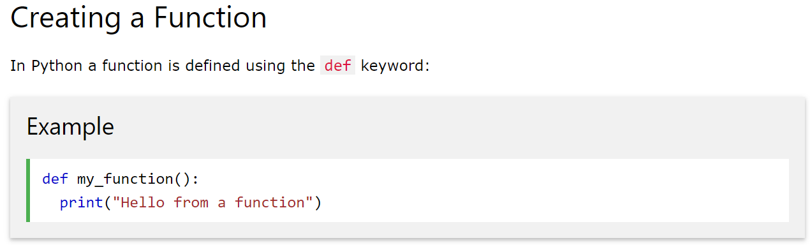
CREATING FUNCTIONS

Slide 37
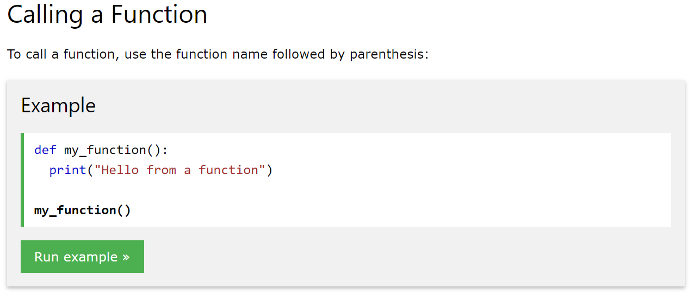
CALLING FUNCTIONS

Slide 38
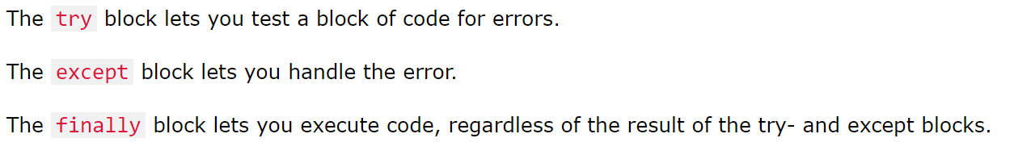
Exception handling

Slide 39
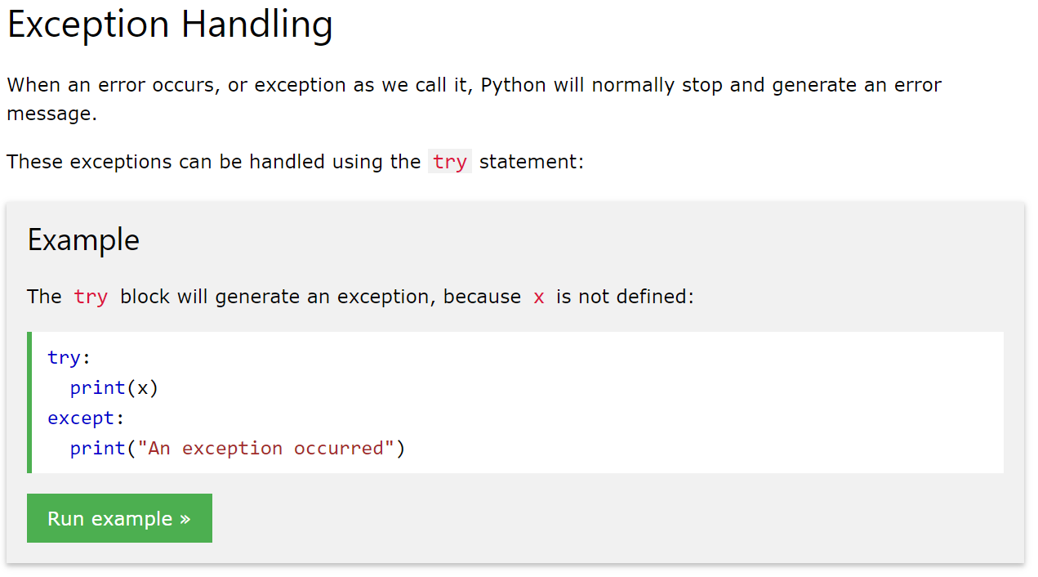
Exception handling

Slide 40
INTERGRATING SQL WITH PYTHON

Slide 41

SQLite
Device Embedded database

Slide 42
SQLITE
Is an embedded SQL database engine.
SQLite does not have a separate server process.
SQLite reads and writes directly to ordinary disk files.

Slide 43
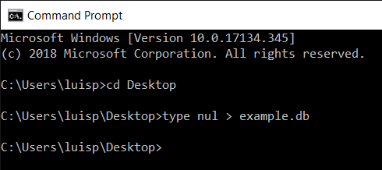
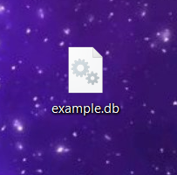
CREATE A .DB FILE
CREATED .db FILE

Slide 44
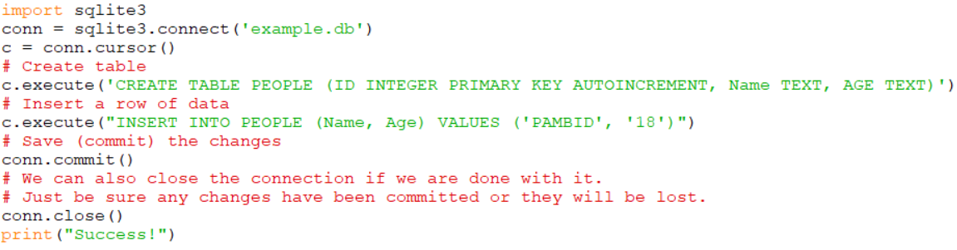
CONNECTING PYTHON

Slide 45
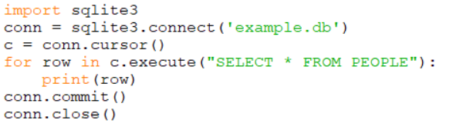
Iterate with result-set

Slide 46

MYSQL
Relational database management system

Slide 47
MYSQL
Is a database server
TCP/IP Protocol is required to send and receive data from the database
Supports structured query language functionalities

Slide 48
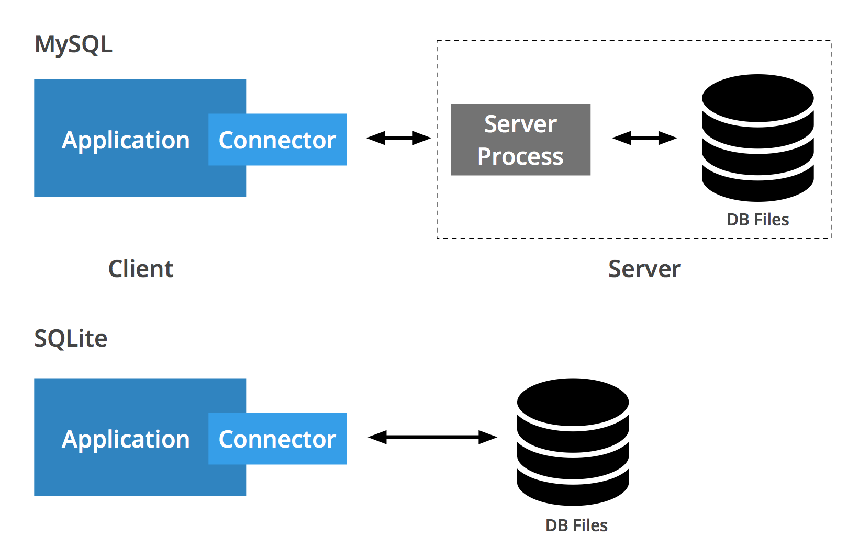
SQLITE VS MYSQL

Slide 49
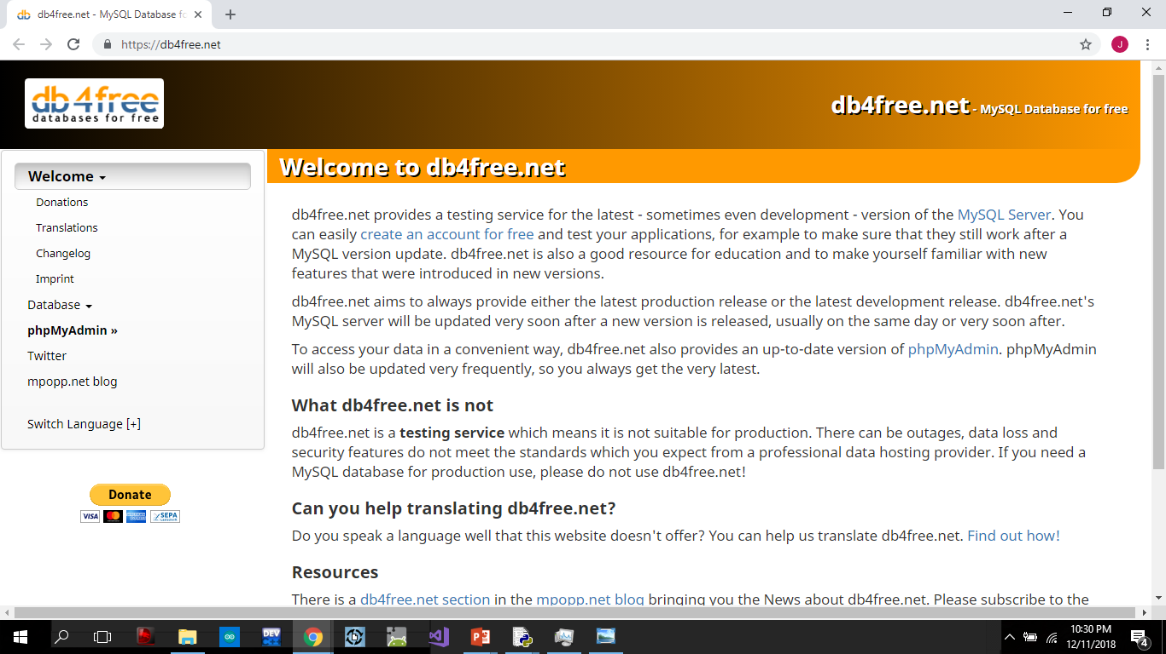
Db4free.net

Slide 50
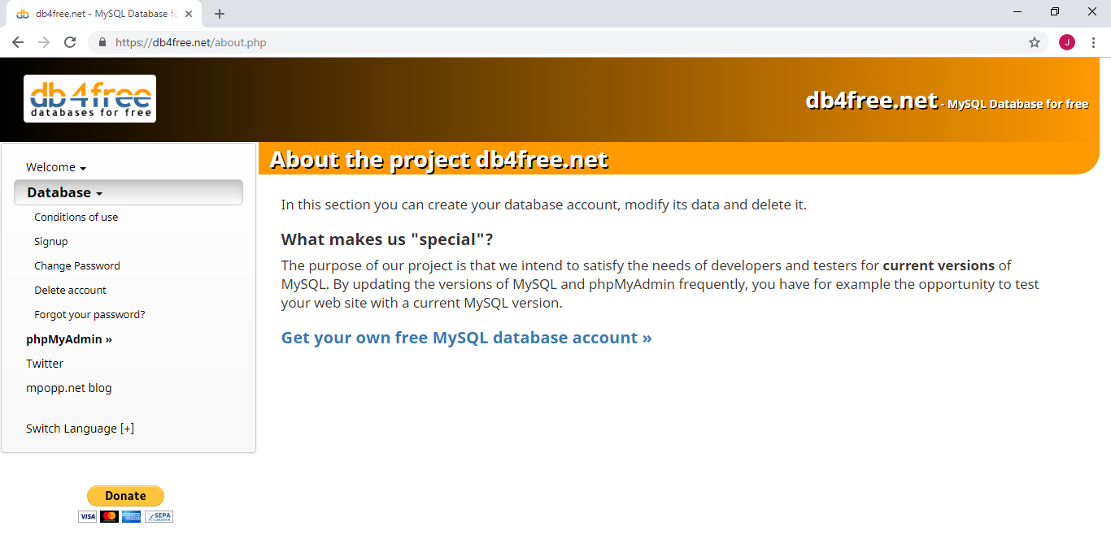
CREATE AN ACCOUNT

Slide 51
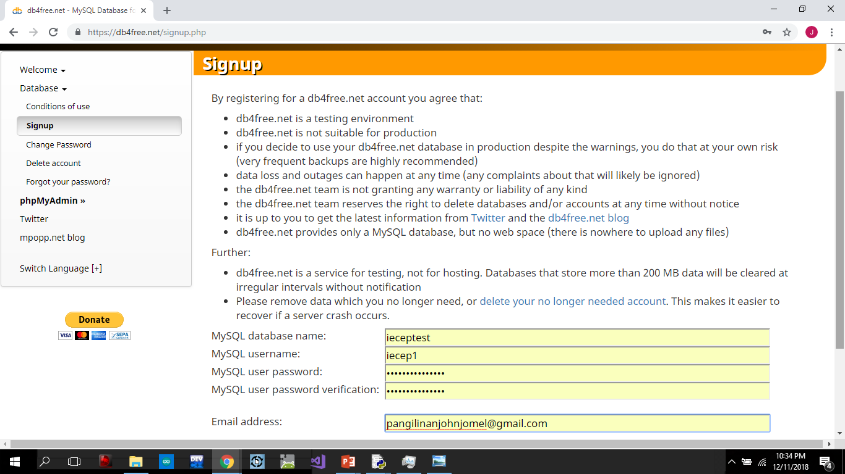
FILL OUT THE FIELDS

Slide 52
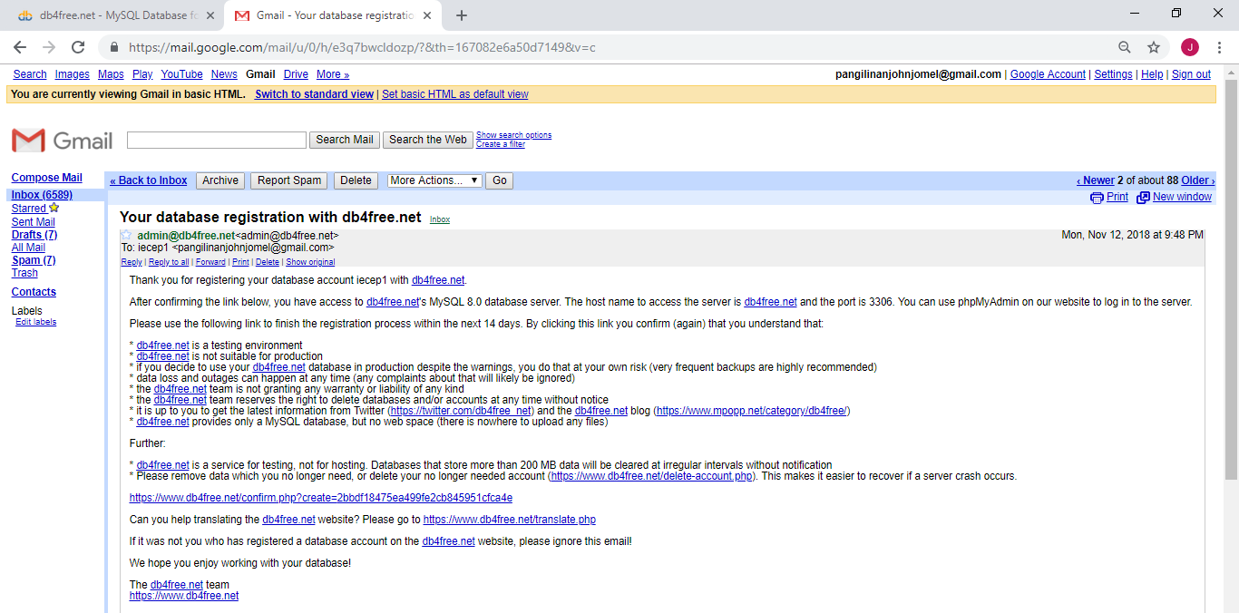
VERIFY YOUR ACCOUNT

Slide 53
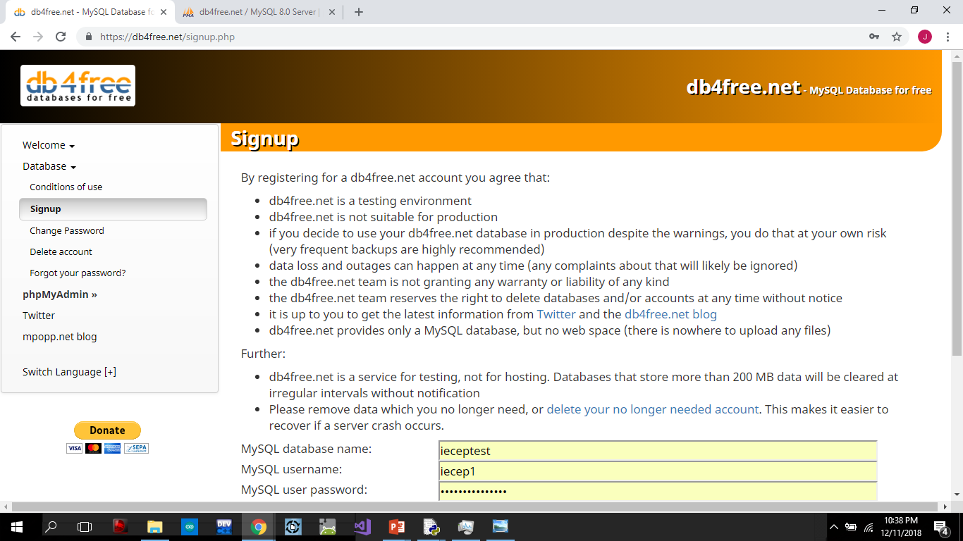
GO TO PHPMYADMIN

Slide 54
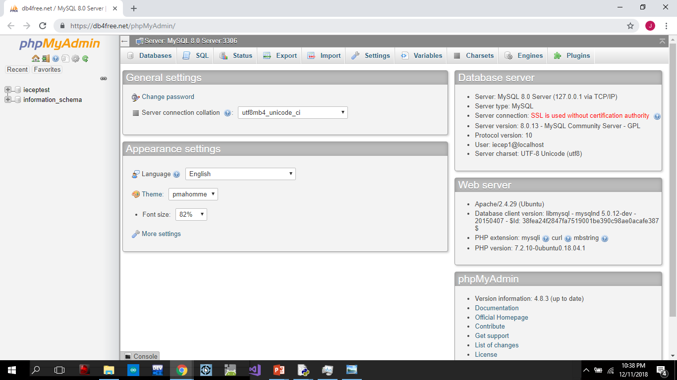

Slide 55
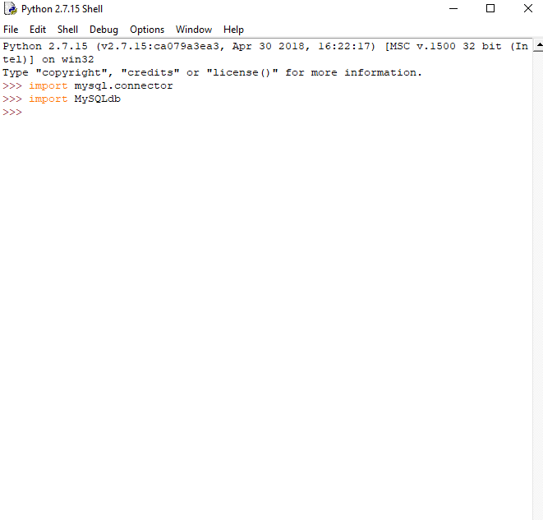
RUN Python IDLE
No errors

Slide 56
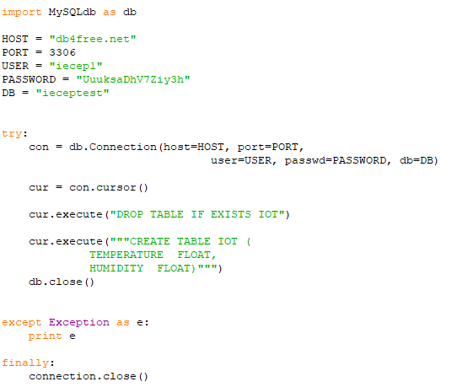
CREATE A TABLE

Slide 57
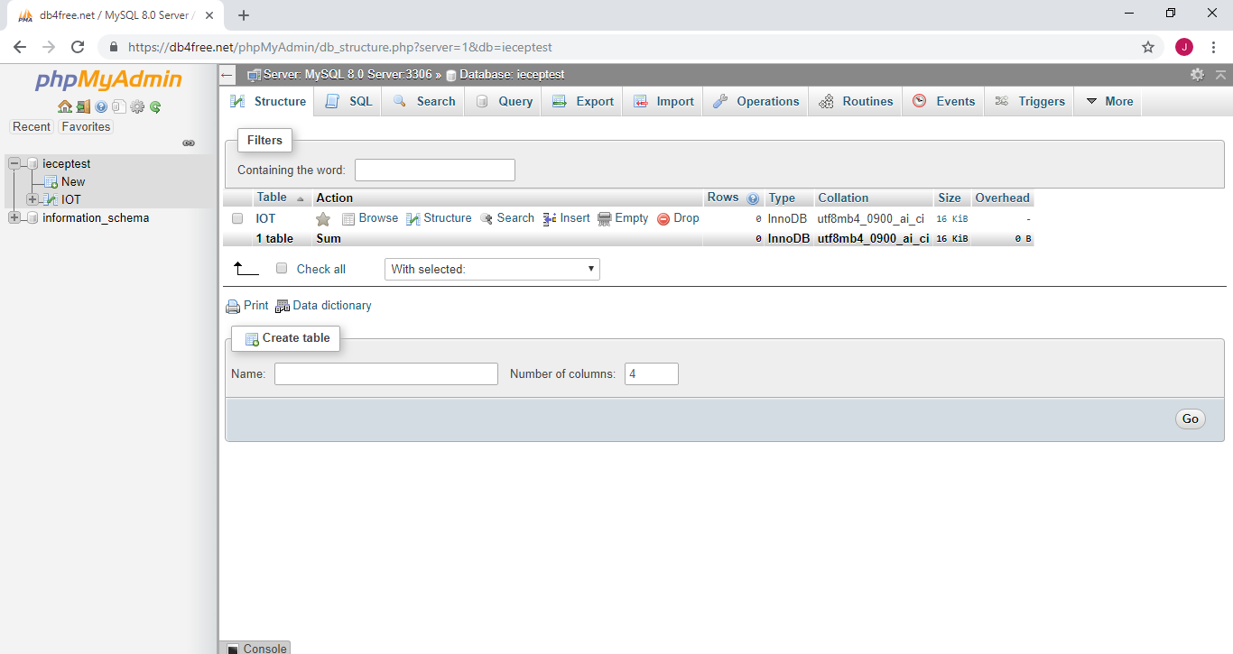

Slide 58
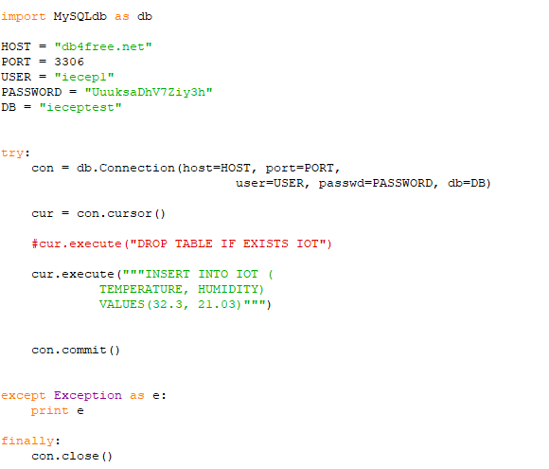
INSERT DATA

Slide 59
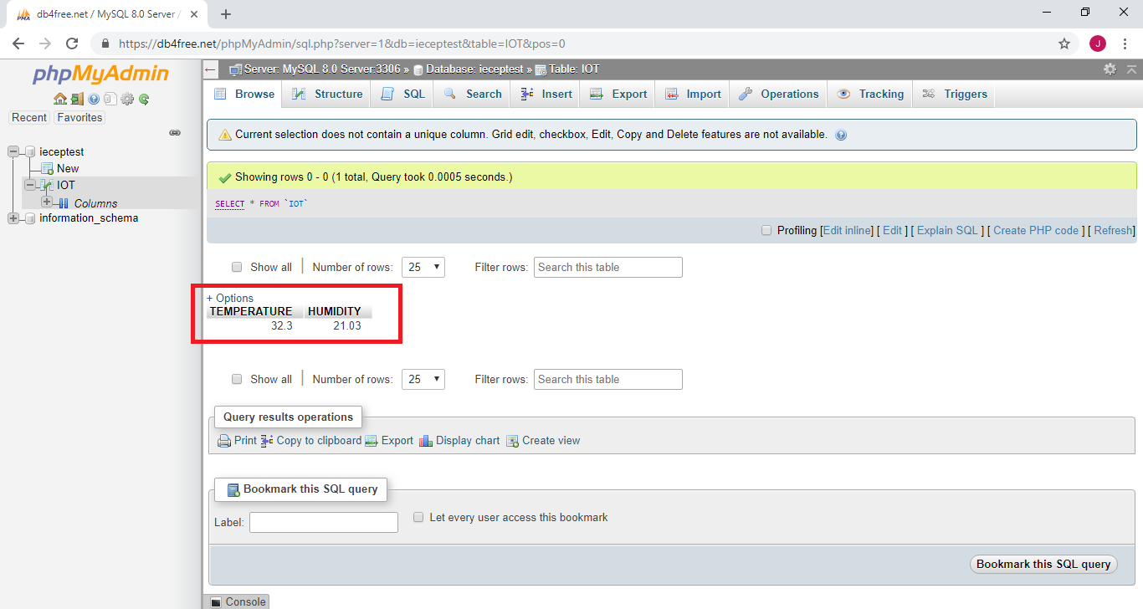

Slide 60
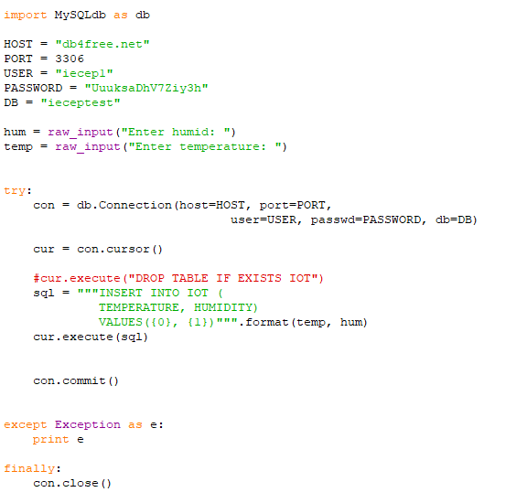
INSERT DATA DYNAMCALLY

Slide 61
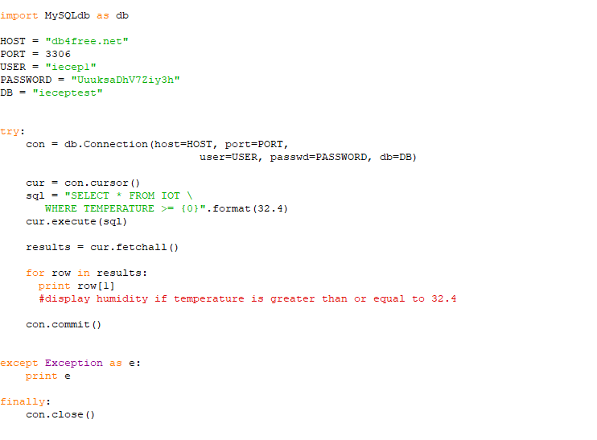
READ ALL DATA WITH CONDITION

Slide 62
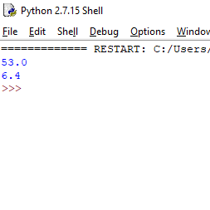

Slide 63
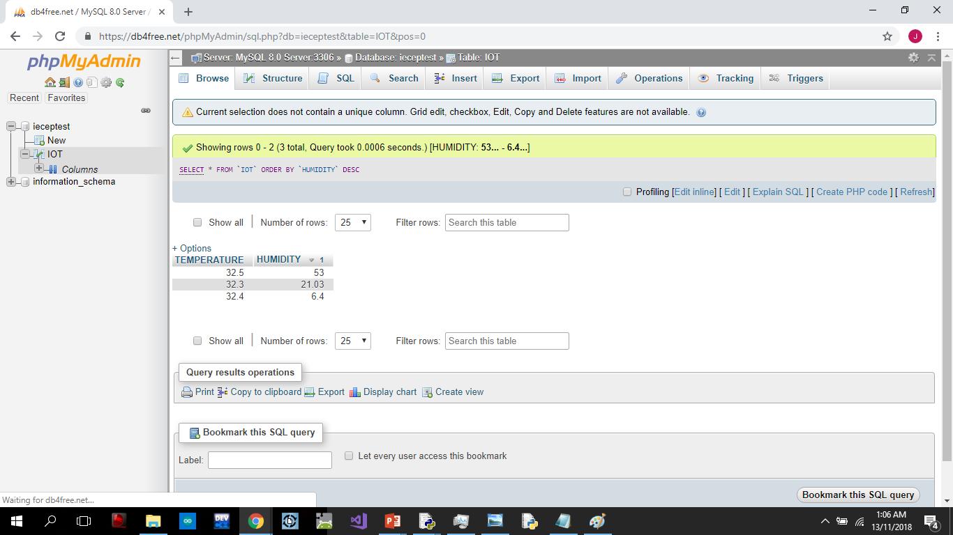

Slide 64
ACTIVITIES

Slide 65
ACTIVITY1
Create a file named “Clinic.db”
Create a program where the database named “Clinic.db” has a table named “PATIENTS”
The columns are:
ID – INTEGER PRIMARY KEY AUTOINCREMENT
NAME – TEXT
AGE – TEXT
The program will ask the user the NAME and AGE then insert the inputs to the table.
The program will show all the records in the table.

Slide 66
ACTIVITY 2
You are working as a software developer, the client asked you to make a grading system for the students. The program will ask for the Name of the student, and the grade. It will then be stored in the database with a table name: StudentGrades.
Make sure that the program will ask the user only 5 times.

Slide 67
ACTIVITY 3
Now that you have already set up the database with a table name: StudentGrades. Create a program that will be able to retrieve the grades of the students. The program will ask for the name of the student, then the program will show the corresponding grade.
Take note of the FORMAT: Student’s Name - Grade

